Slide 1
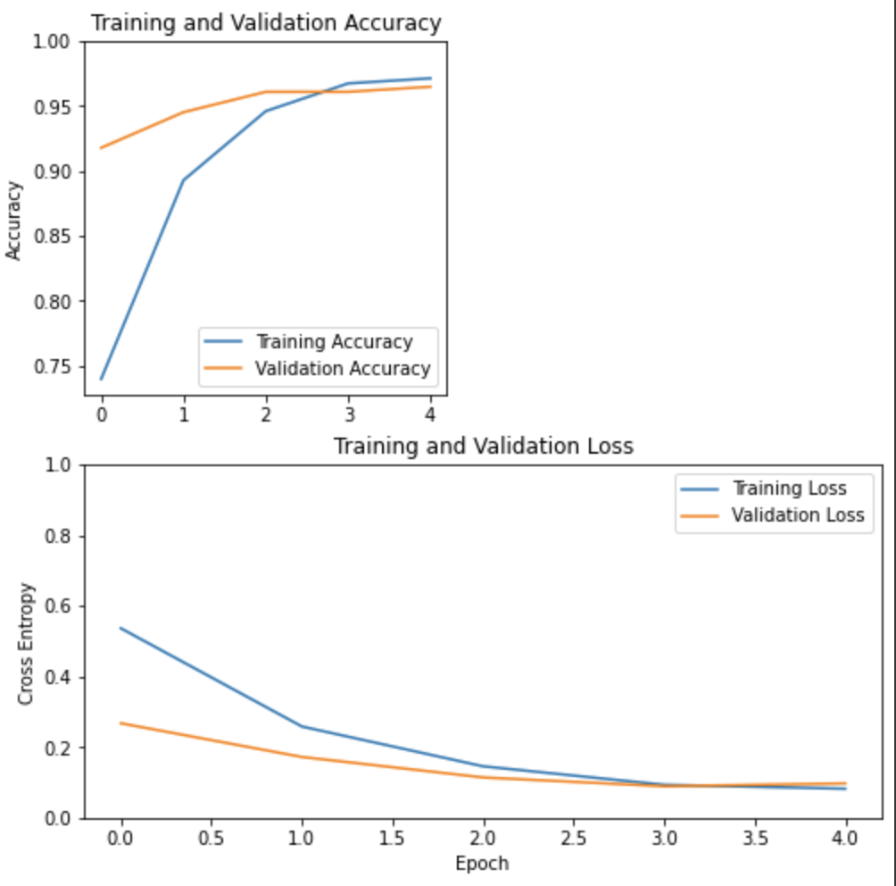
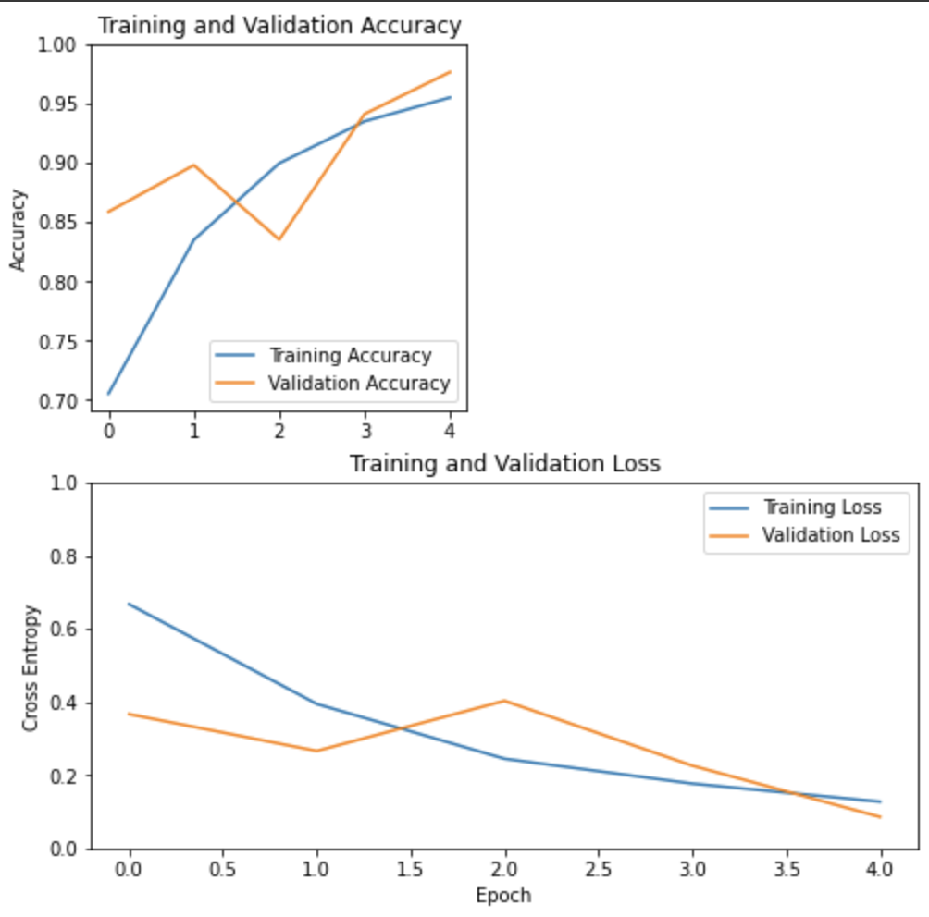
Binary Models
Model 3: (32, 64)
Model 5: (64, 32)

Slide 2
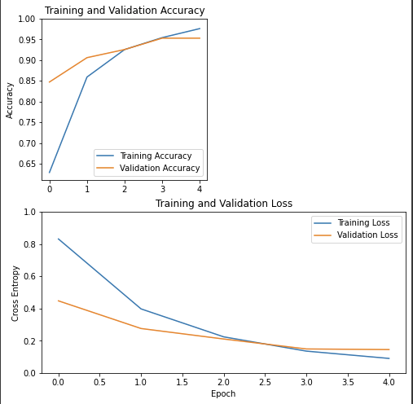
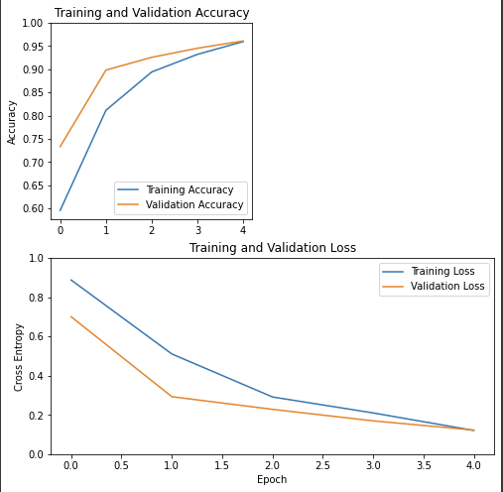
Trinary Models
Model 2: (64, 32)
Model 5: (64, 32, 16)

Slide 3
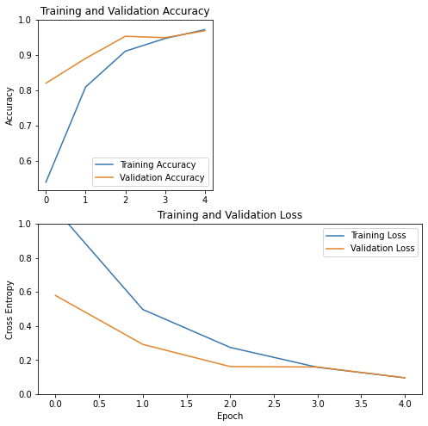
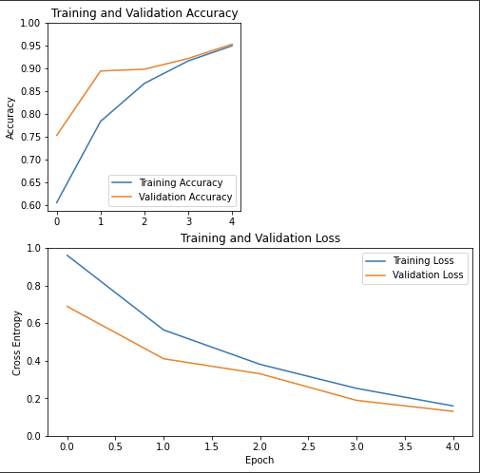
Main Models
Model 3: (64, 32)
Model 6: (64, 32, 16)

